Slide 1

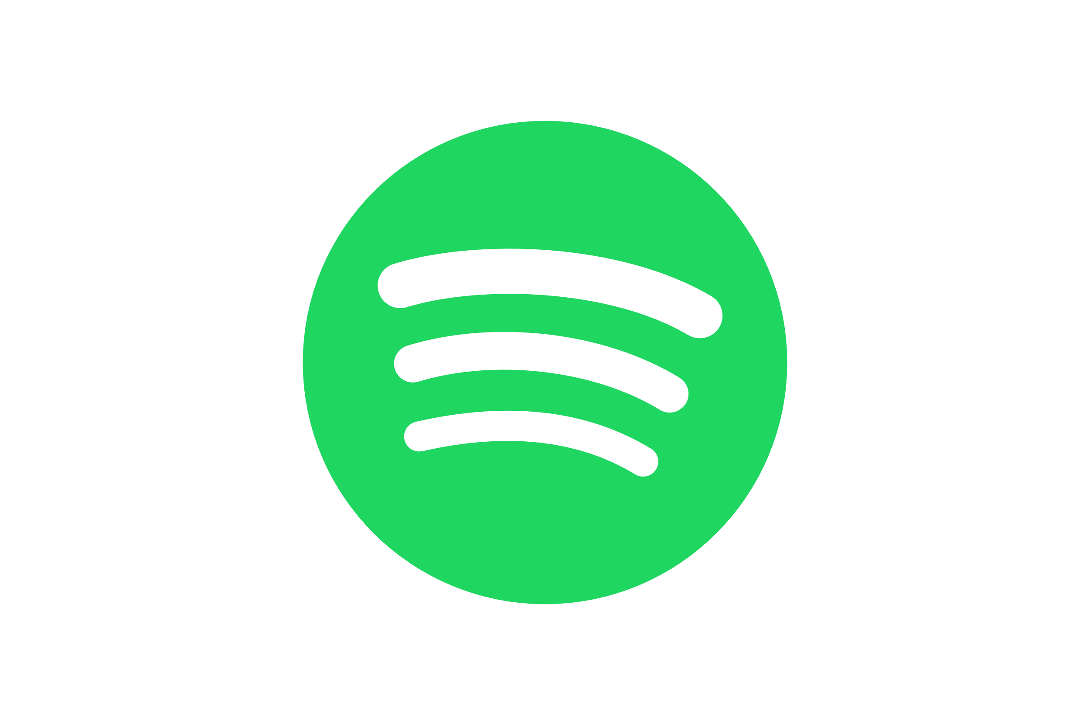
Analysing listening behaviour on Spotify
The useage of spotify API to analyse aggregated data

Slide 2
Do you listen to music via a streaming plattform such as Spotify or Apple Music?

Slide 3
Do you listen to music via a streaming plattform such as Spotify or Apple Music?
2nd Quarter of 2022: 616.2 million music streaming subscribers
→ 188 million: paying Spotify users
For comparison → 3rd Quarter of 2023: 226 million paying Spotify users
Source: [1]

Slide 4
Deep Dive
“Is there a cause of music listening?”
→ regulate arousal and their mood !
Source: [2]
“What influences the mood?”
→ healthiness, personal environment and global events !
“Is it possible to track the user behavior in connection to global events?”

Slide 5
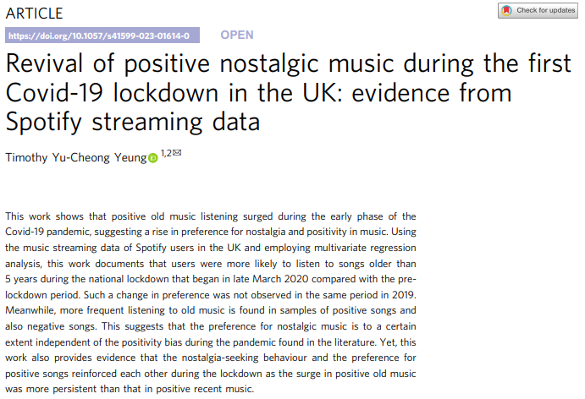
Inspirational paper
Source: [3]

Slide 6
Research Question
Do global events impact the preferences and consumption patterns of music?
A research study about the type of music people in Ukraine listened to during 2022 using Spotify API.

Slide 7
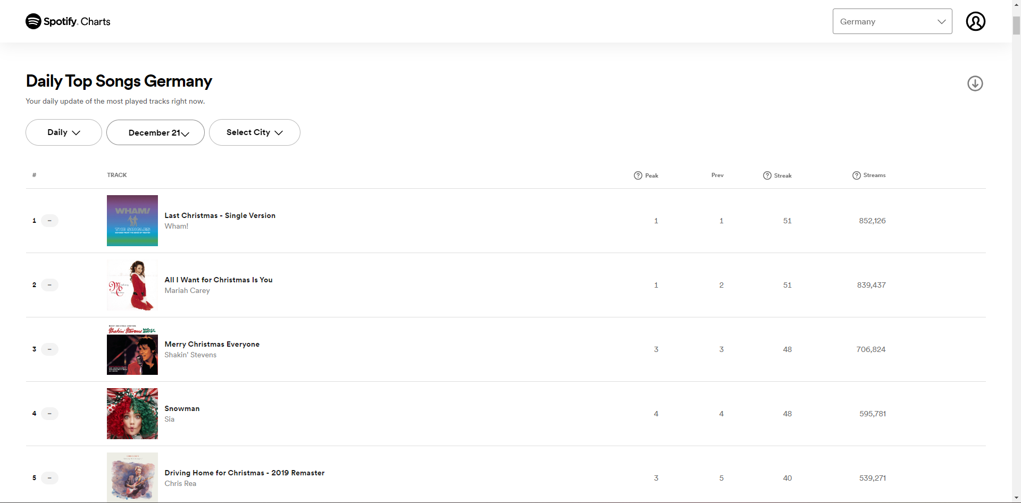
How did I get the data?
Source: [4]

Slide 8
Next process steps for data
Got data by hand via charts website (weekly data)
Used Spotify API to get the track ID‘s automatically
Used Spotify API to get track information (such as popularity and certain audio features)
Merged weekly TOP200 with the song information for a full data set

Slide 9
Overview of the data
Weekly TOP200 streamed songs
starting by week of 6th January 2022, ending with week of 29th December 2022 (52 weeks)
Data: 17 variables and 10.400 (52*200) entries
In total 930 different songs
Measures: streams, week of, popularity, danceability, energy, loudness, speechiness, acousticness, instrumentalness, valence, tempo, duration in ms

Slide 10
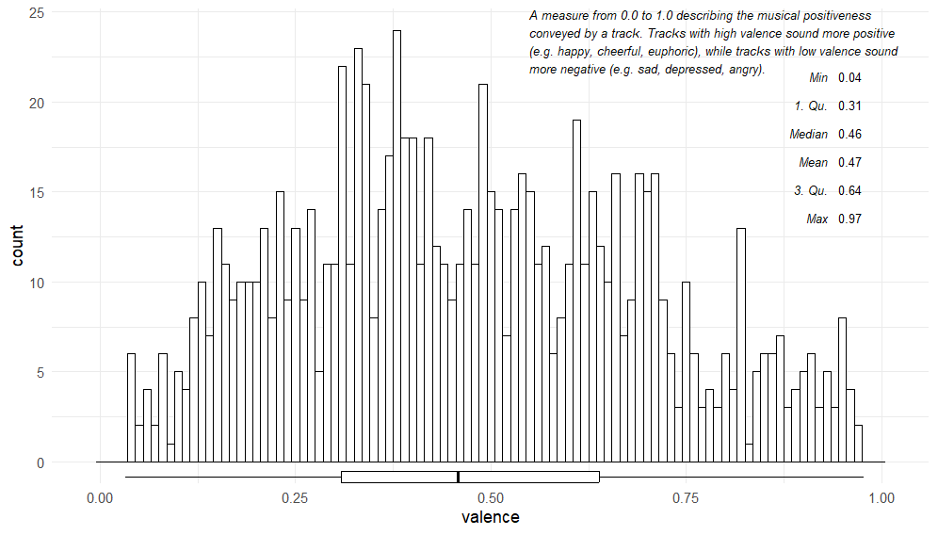
Distribution of valence in all 930 songs

Slide 11
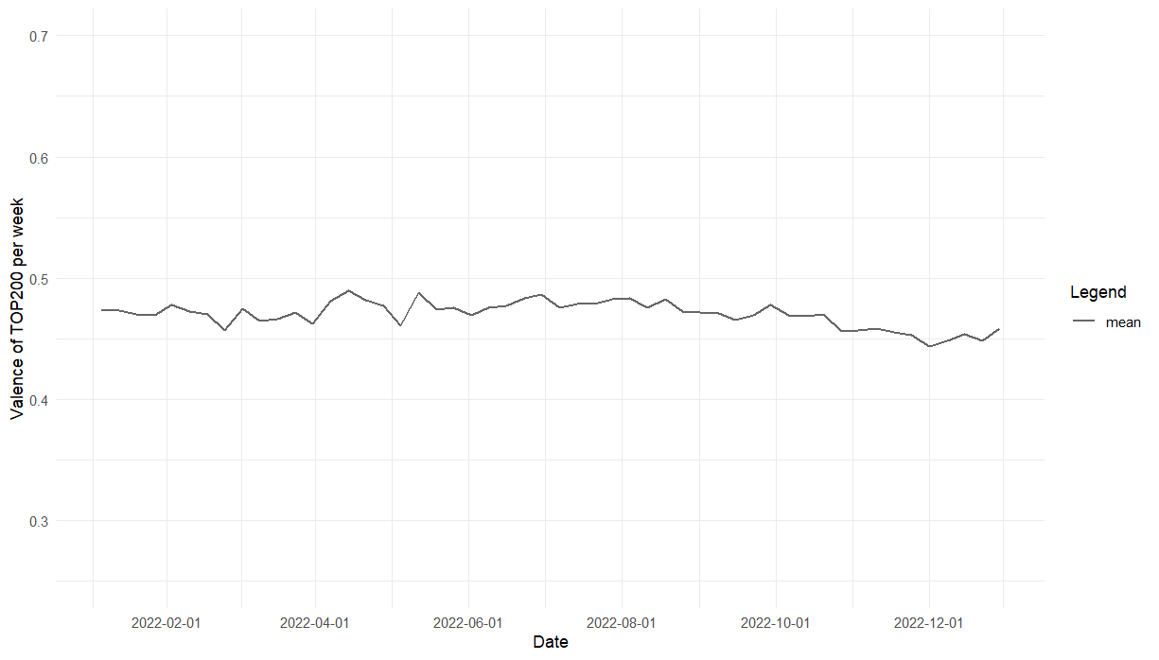
Trend of valence over time

Slide 12
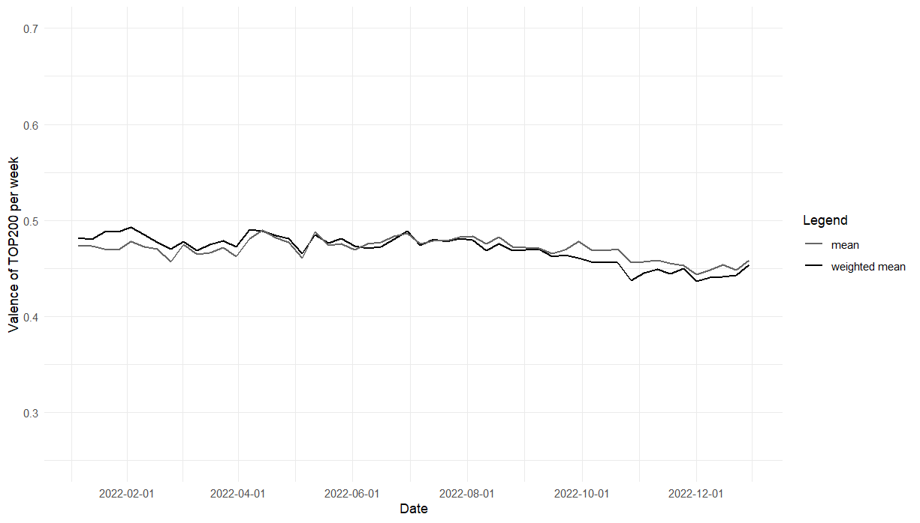
Trend of valence over time

Slide 13
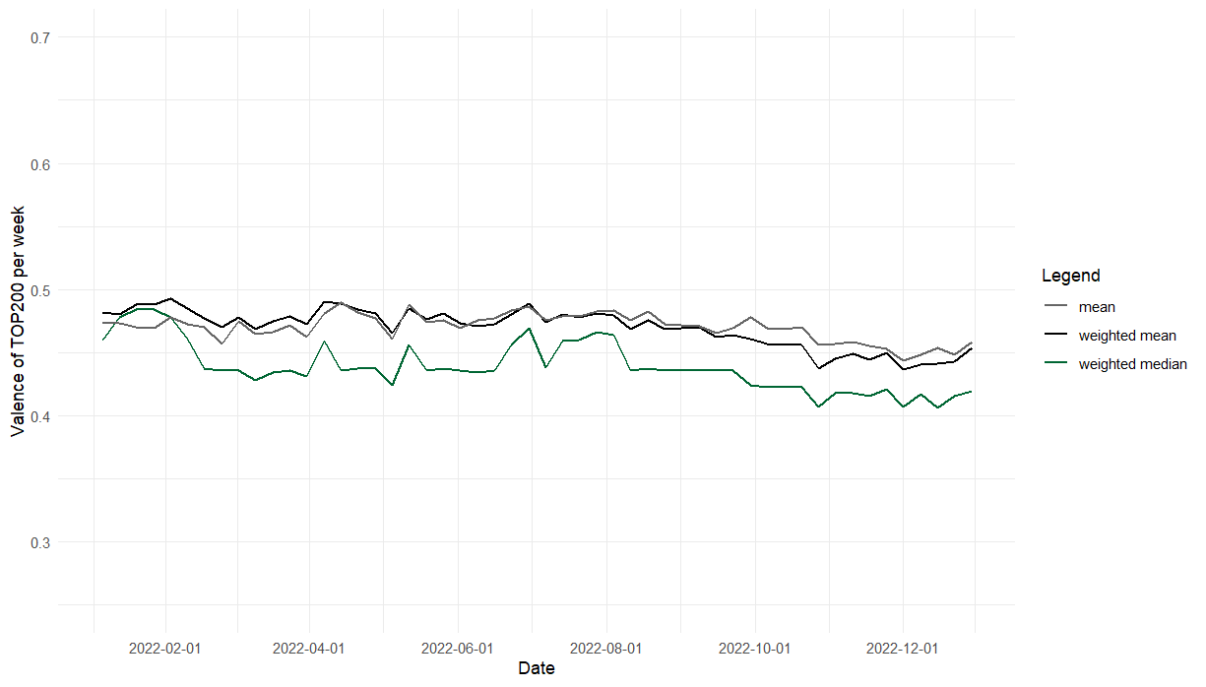
Trend of valence over time

Slide 14
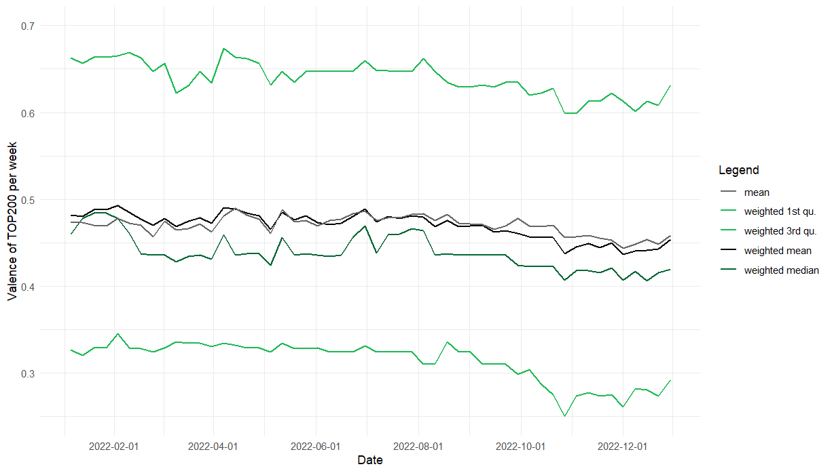
Trend of valence over time

Slide 15
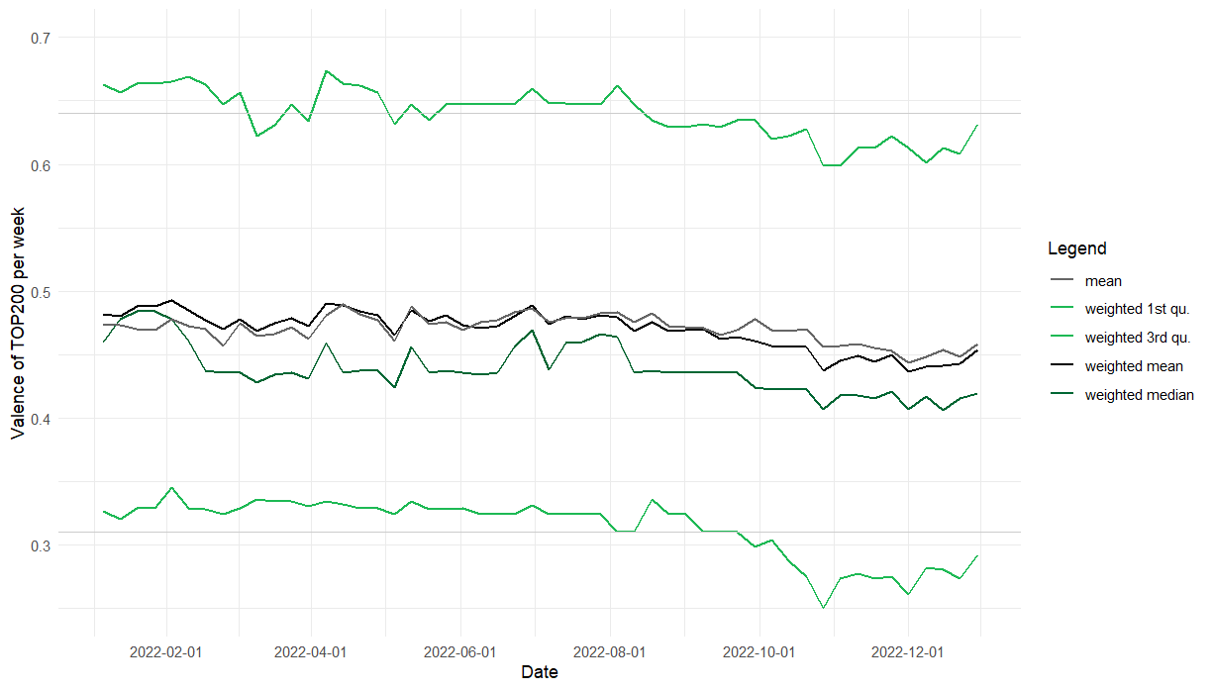
Trend of valence over time

Slide 16
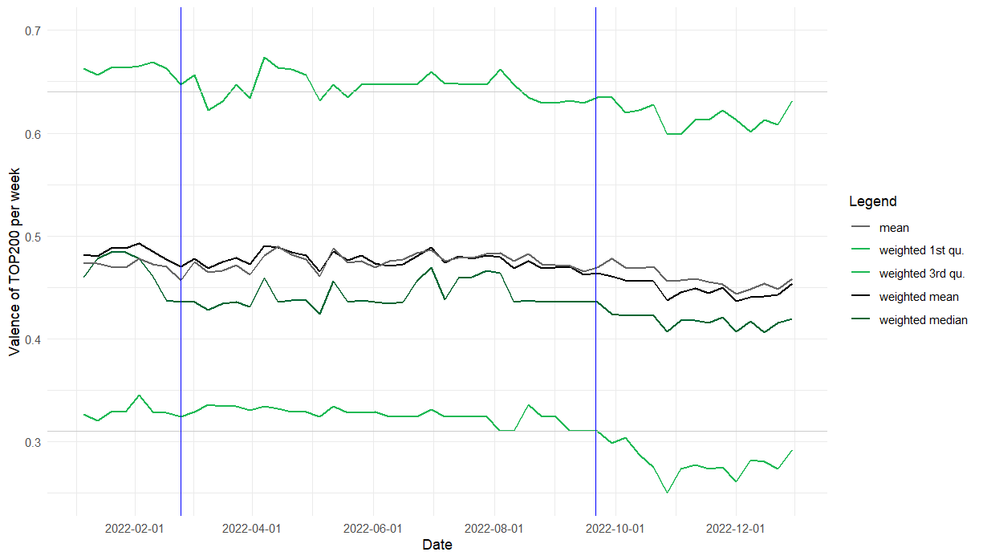
Trend of valence over time
Russia invades Ukraine
Russia‘s mobilisation

Slide 17
What‘s next?
Analyse all the other variables
Try to find similarities in ups and downs

Slide 18
References
[1] https://www.statista.com/topics/6408/music-streaming/#editorsPicks
[2] Schäfer T, Sedlmeier P, Städtler C, Huron D. The psychological functions of music listening. Front Psychol. 2013 Aug 13;4:511. doi: 10.3389/fpsyg.2013.00511. PMID: 23964257; PMCID: PMC3741536.
[3] Yeung, T.YC. Revival of positive nostalgic music during the first Covid-19 lockdown in the UK: evidence from Spotify streaming data. Humanit Soc Sci Commun 10, 132 (2023). https://doi.org/10.1057/s41599-023-01614-0
[4] https://charts.spotify.com/charts/view/regional-de-weekly/2023-12-21

